Slide 1
TinkerCad Models Templates
Template
Comparing Lots of Models
Which is Best: Bad, Ok, Good
Completed Model to Spec
Student Success Criteria by lesson -Web App
Notes:
Get children to identify the purpose of the game
Think about the size of the pathways and the size of the ball
How does the game end?
Show the real thing - how it is glued to cardboard with a hole in it!
Dimensions: 90mm x90mm. Wall height

Slide 2
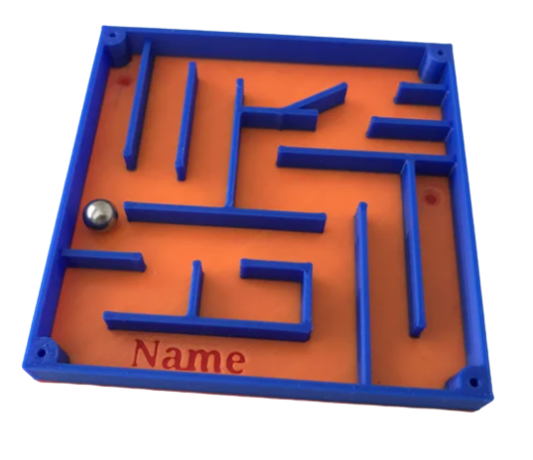
We are going to make a…..
What skills do we need?
MOVING BALL MAZE
What needs to happen in the game?
What problems might happen when we design it?
How does the game end?
Notes:
Get children to identify the purpose of the game
Think about the size of the pathways and the size of the ball
How does the game end?
Show the real thing - how it is glued to cardboard with a hole in it!
Dimensions: 90mm x90mm. Wall height

Slide 3
Learning Objectives
Design and create a functional 3D maze for 3D printing
Apply precise measurement and spacing techniques
Demonstrate advanced TinkerCAD skills
Prepare design files for sharing and printing

Slide 4
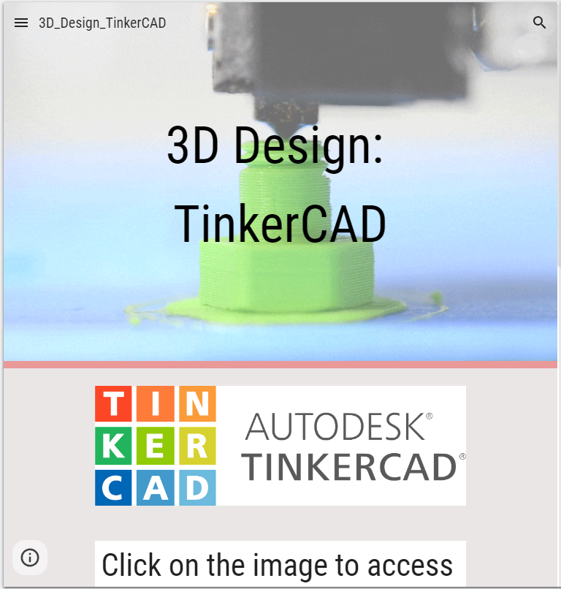
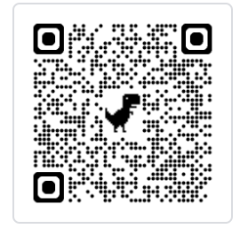
Lesson 1 - TinkerCad Skills Recap
TinkerCad Maze Project
Activity:
Join the TinkerCad classroom
Open a new TinkerCad Project
Enter TinkerCad from Google Classroom
Look at the Tutorial Page
Watch the videos to learn/recap TinkerCad skills
Practice: Move, Rotate, Scale, Duplicate tools
Create 3 simple shapes and practice grouping them
Notes:
https://sites.google.com/bisvietnam.com/y4-tinkercad-moving-ball-maze/moving-ball-maze

Slide 5
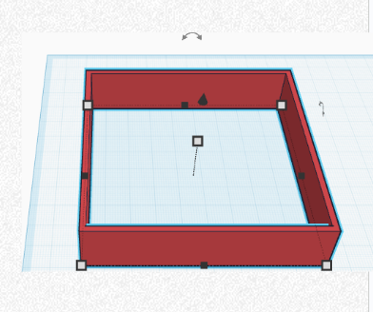
Lesson 2 - Create Outer Frame
Activity:
Create new design project named "Your Name - Maze"
Build outer frame using Box tool (90mm x 90mm x 20mm)
Create wall strips (90mm x 2mm x 20mm)
Duplicate wall, rotate 90°, position to form complete frame
Group outer frame together and lock it
Measure to confirm exact 90mm x 90mm dimensions

Slide 6
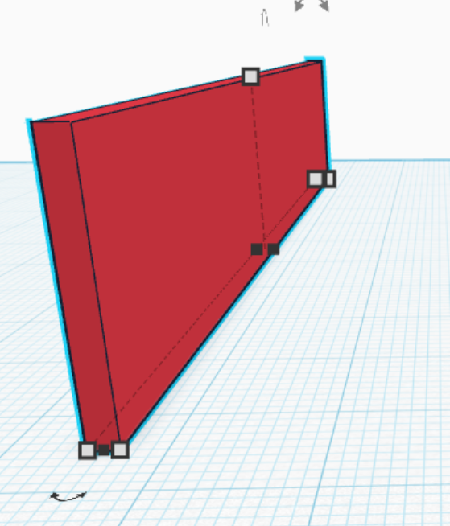
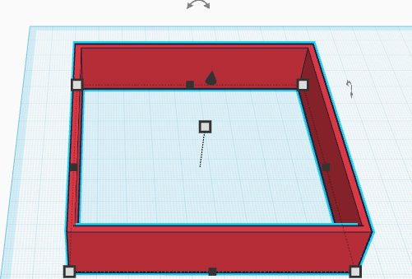
Wall height: 20mm
90mm
90mm
Wall width: 2mm
90mm

Slide 7
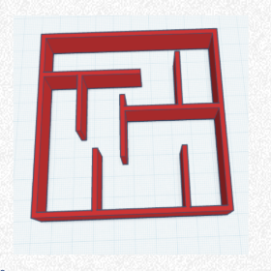
Lesson 3 - Add Basic Interior Walls
Activity:
Create first interior wall (length varies x 2mm x 20mm)
Attach wall to outer frame - must touch an outer wall
Practice rotating walls at exactly 90° or 45° only
Wall height: 20mm
Add 2-3 more interior walls
90mm
Check: Leave exactly 10mm space between all walls
Wall width: 2mm
Group interior walls with outer frame

Slide 8

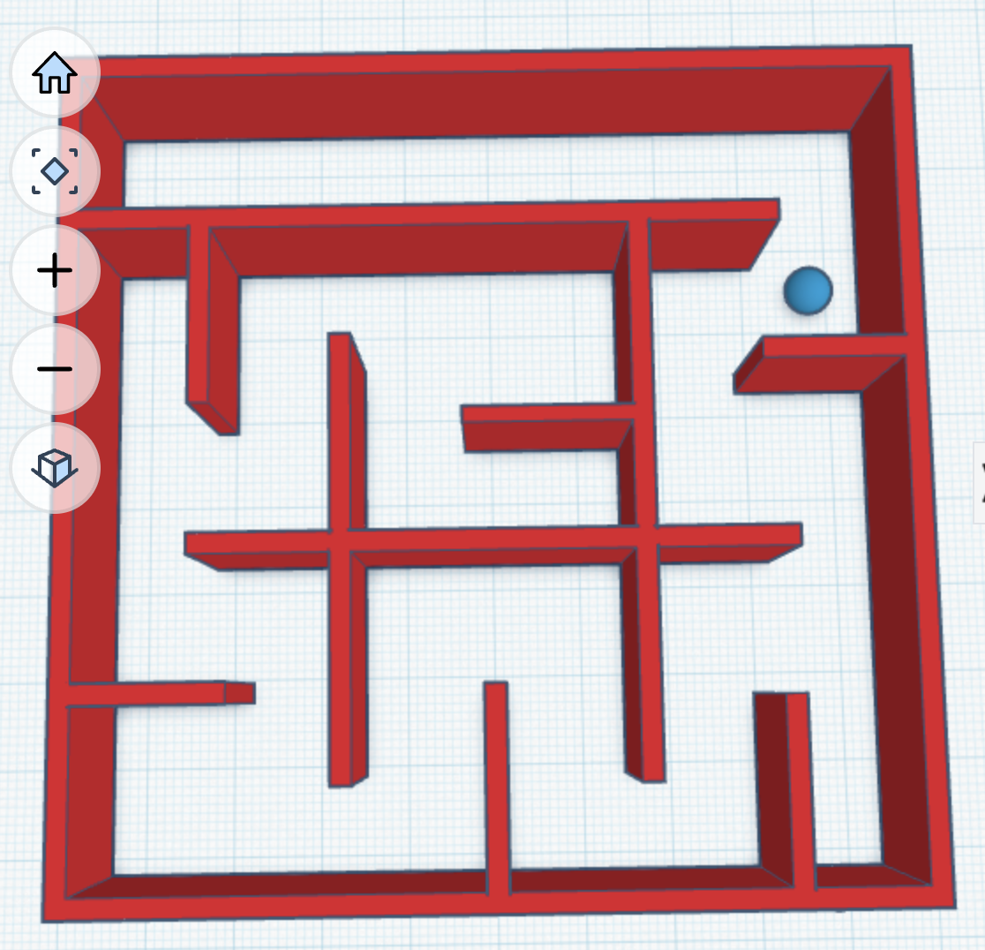
Lesson 4 - Skills Practice & Ball Testing
Activity:
Create test ball (5mm x 5mm x 5mm sphere)
Place ball in maze and test if it fits through gaps
Practice Challenge: Create perfect 90° corner joint
Rotate walls using exact degree measurements
Test: Ball should move freely with 10mm spacing
Fix any walls that are too close together

Slide 9
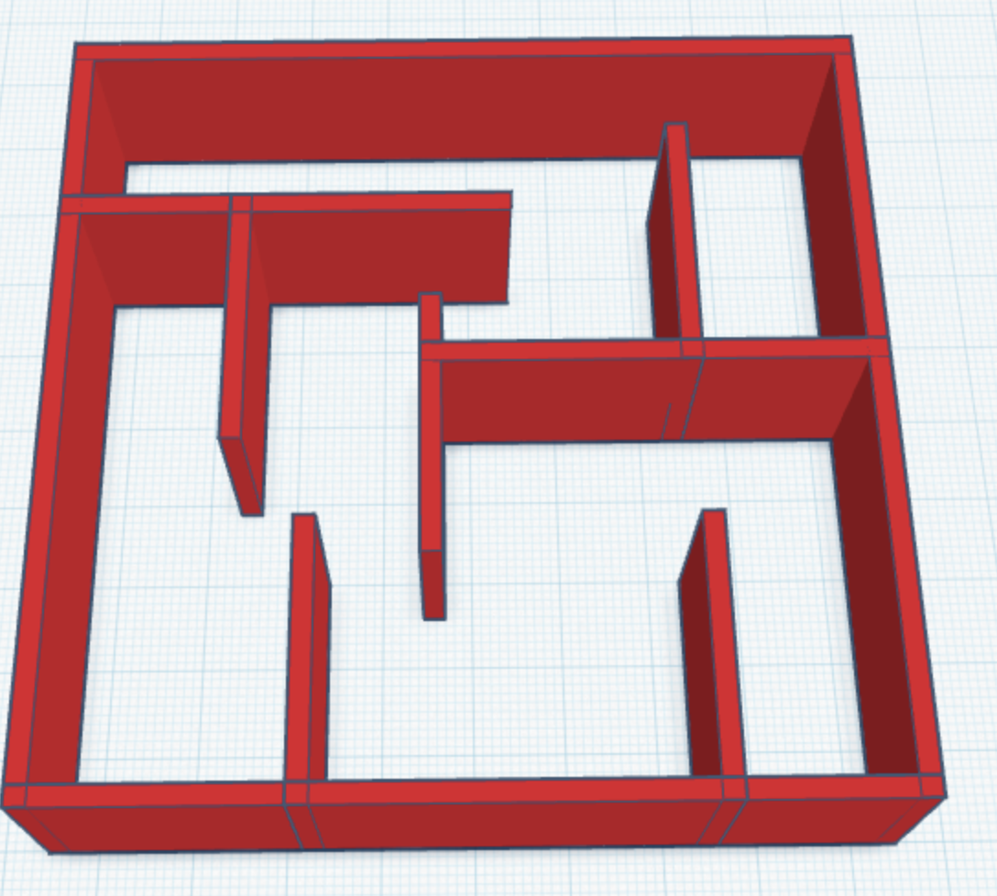
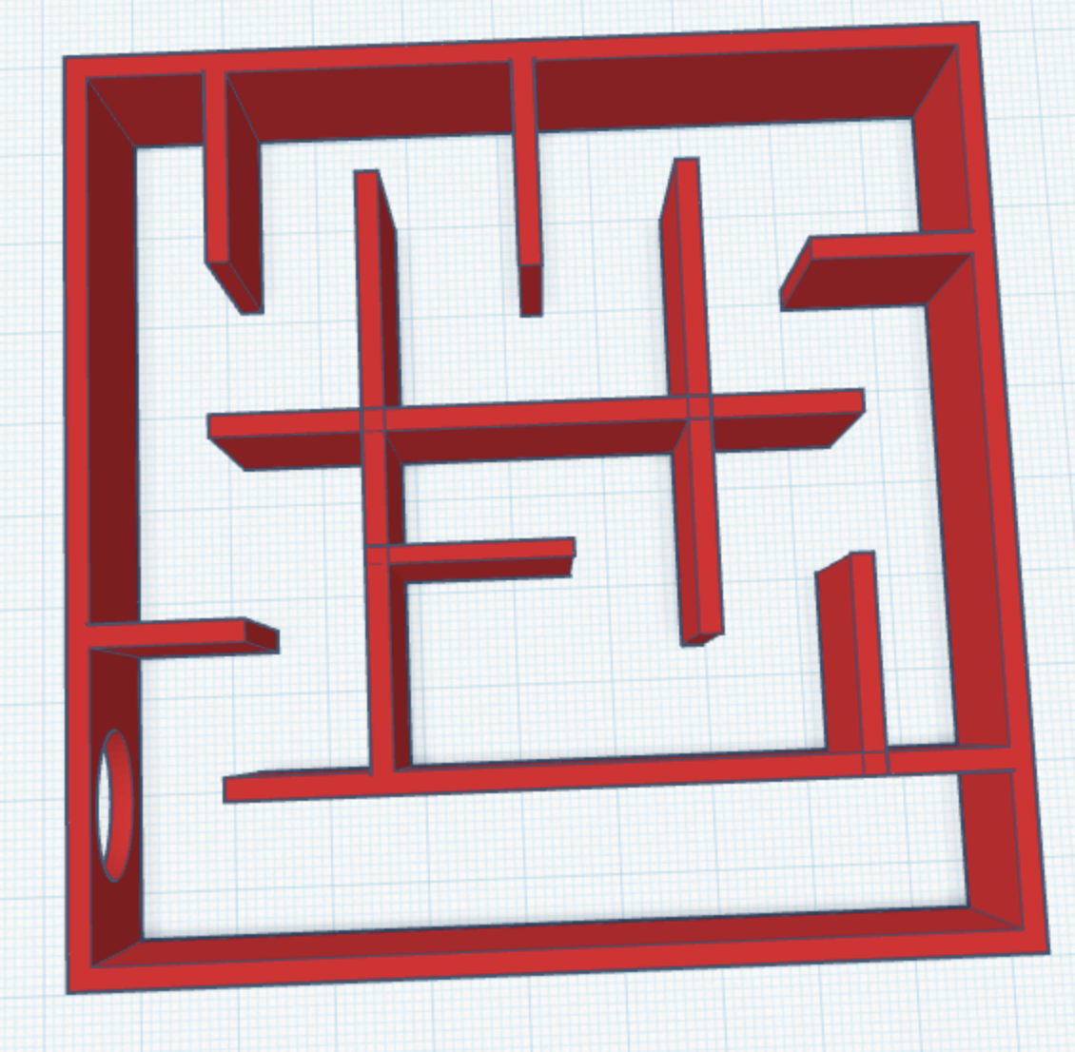
Lesson 5 - Controlled Complexity
Activity:
Add maximum 3 more interior walls to your design
Each new wall must connect to existing walls
Use practiced rotation skills (90° or 45° only)
CHECKPOINT: Test ball navigation before adding more
Create one dead end and one clear path
Group all new elements together

Slide 10
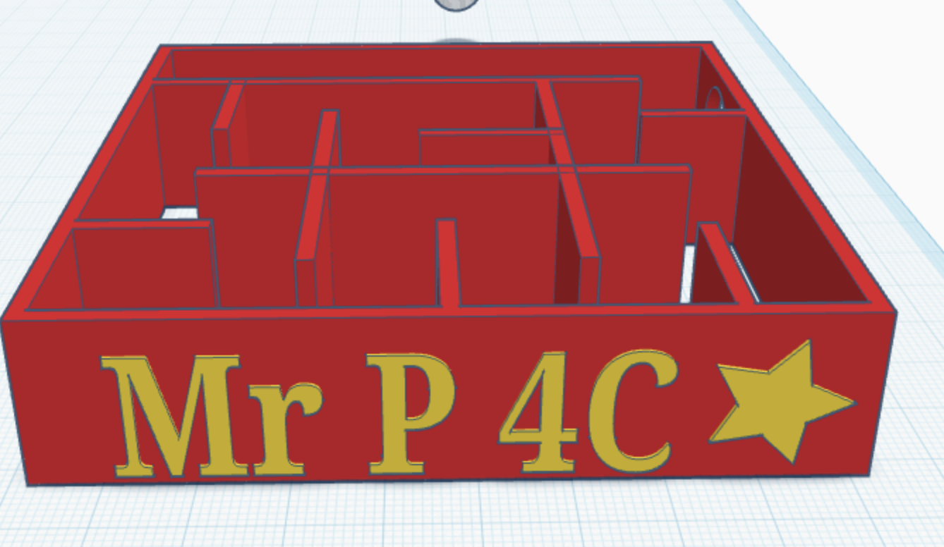
Lesson 6 - Add Text and Decoration
Activity:
Add your name using Text tool
Size text to 90% of wall dimensions
Position text on outer wall surface
Make text extrude 1mm from wall surface
Optional: Add simple decorative shapes
Group text with wall it's attached to

Slide 11
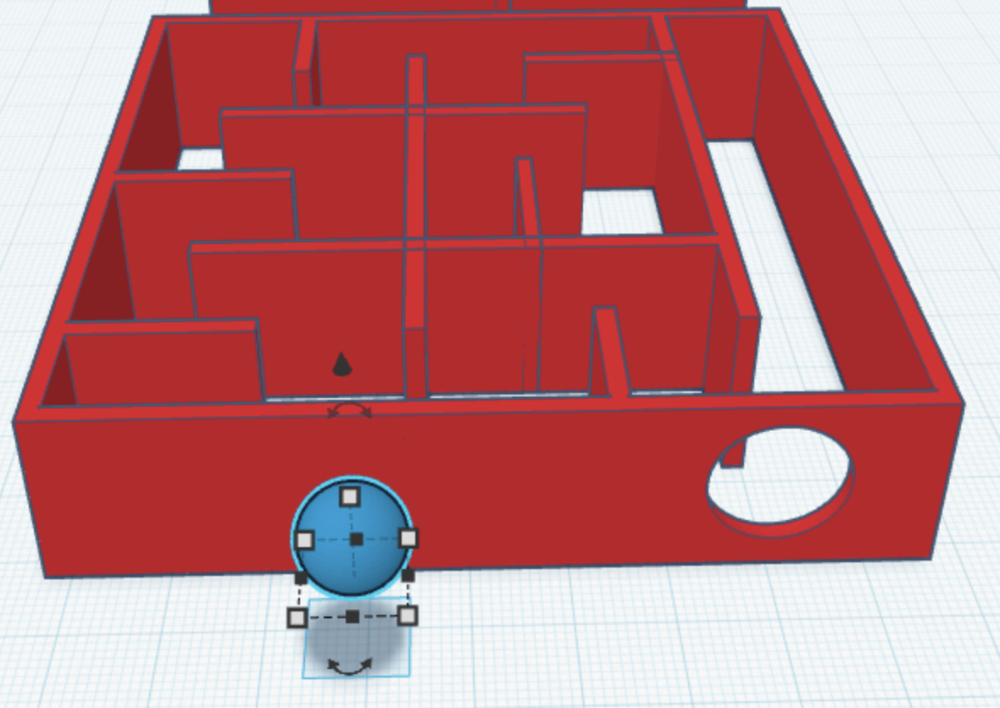
Lesson 6 - Create Exit Hole/Shape
Activity:
Choose location for exit hole in outer wall
Create cylinder: 15mm diameter x 15mm deep
Position cylinder to cut through wall completely
Use hole tool to subtract cylinder from wall
Test: 5mm ball should pass through easily
Ensure hole doesn't weaken wall structure

Slide 12
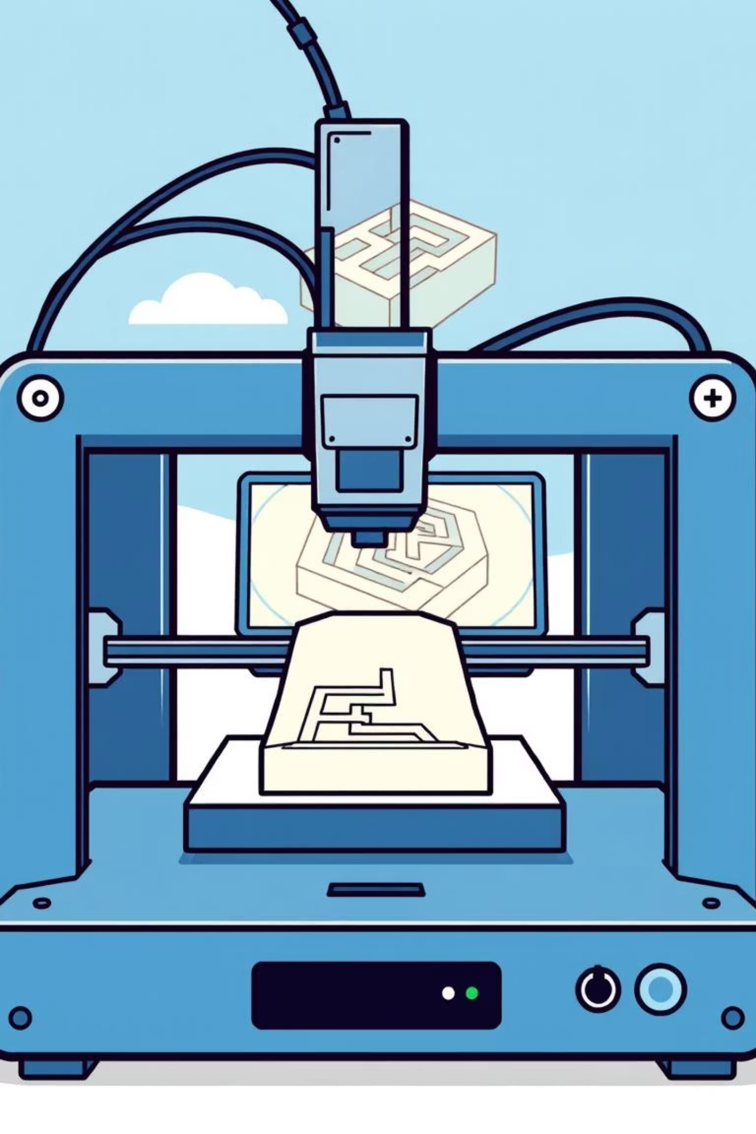
Quality Control & Prepare for Printing
Activity:
Use Quality Control Checklist (see next slide)
Delete test ball from design
Check all measurements are correct
View design from all angles
Fix any floating or disconnected parts
Share design link for 3D printing submission
Share link to Padlet
Notes:
https://padlet.com/patrickcantillon/maze-links-25-26-dnnsa6m9e9q2051x

Slide 13
Quality Control Checklist
Before sharing for 3D printing:
☐ Delete the test ball
☐ Walls meet minimum spacing (10mm)
☐ Check nothing is floating
☐ Maze is exactly 90mm x 90mm
☐ Delete any unwanted shapes
☐ Exit hole is 15mm x 15mm x 15mm
☐ All shapes are grouped
☐ Your name is on the maze
☐ Walls are 20mm Height
☐ Walls are 2mm Thick

Slide 14
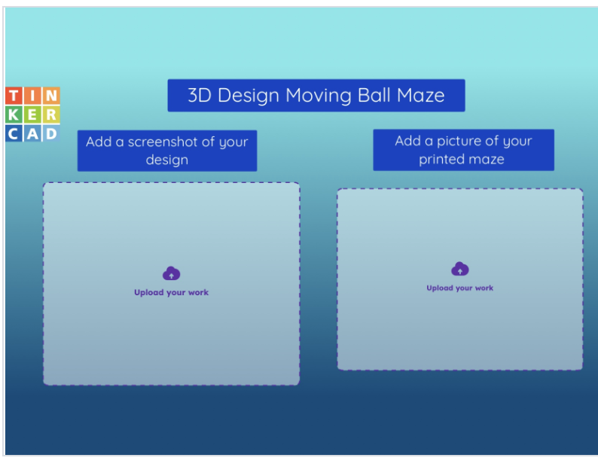
Evaluation
Notes:
https://app.seesaw.me/pages/shared_activity?prompt_id=prompt.3bd25423-2d45-4839-9465-0c7969cae76c&share_token=-Urf1UqWT8mDJ-G3yCjsTw

Slide 15
Resources to be used at your own discretion
—------------------------>

Slide 16
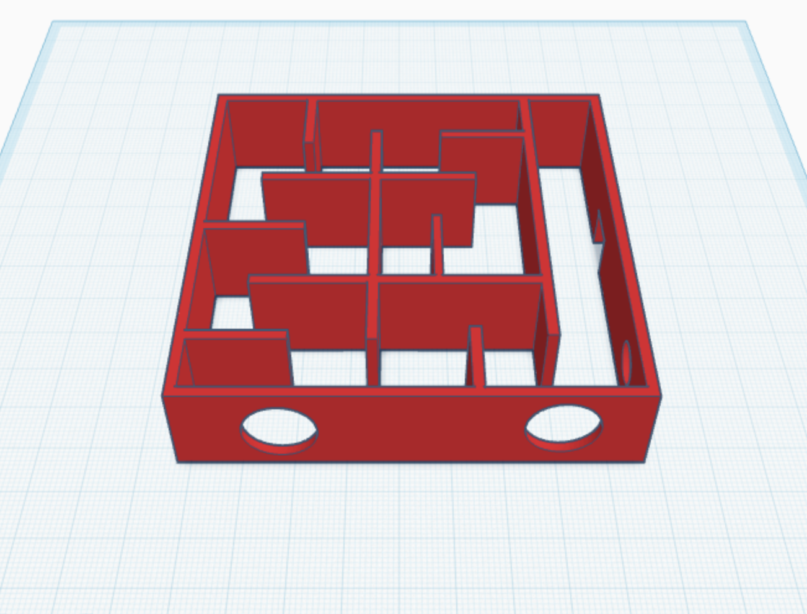
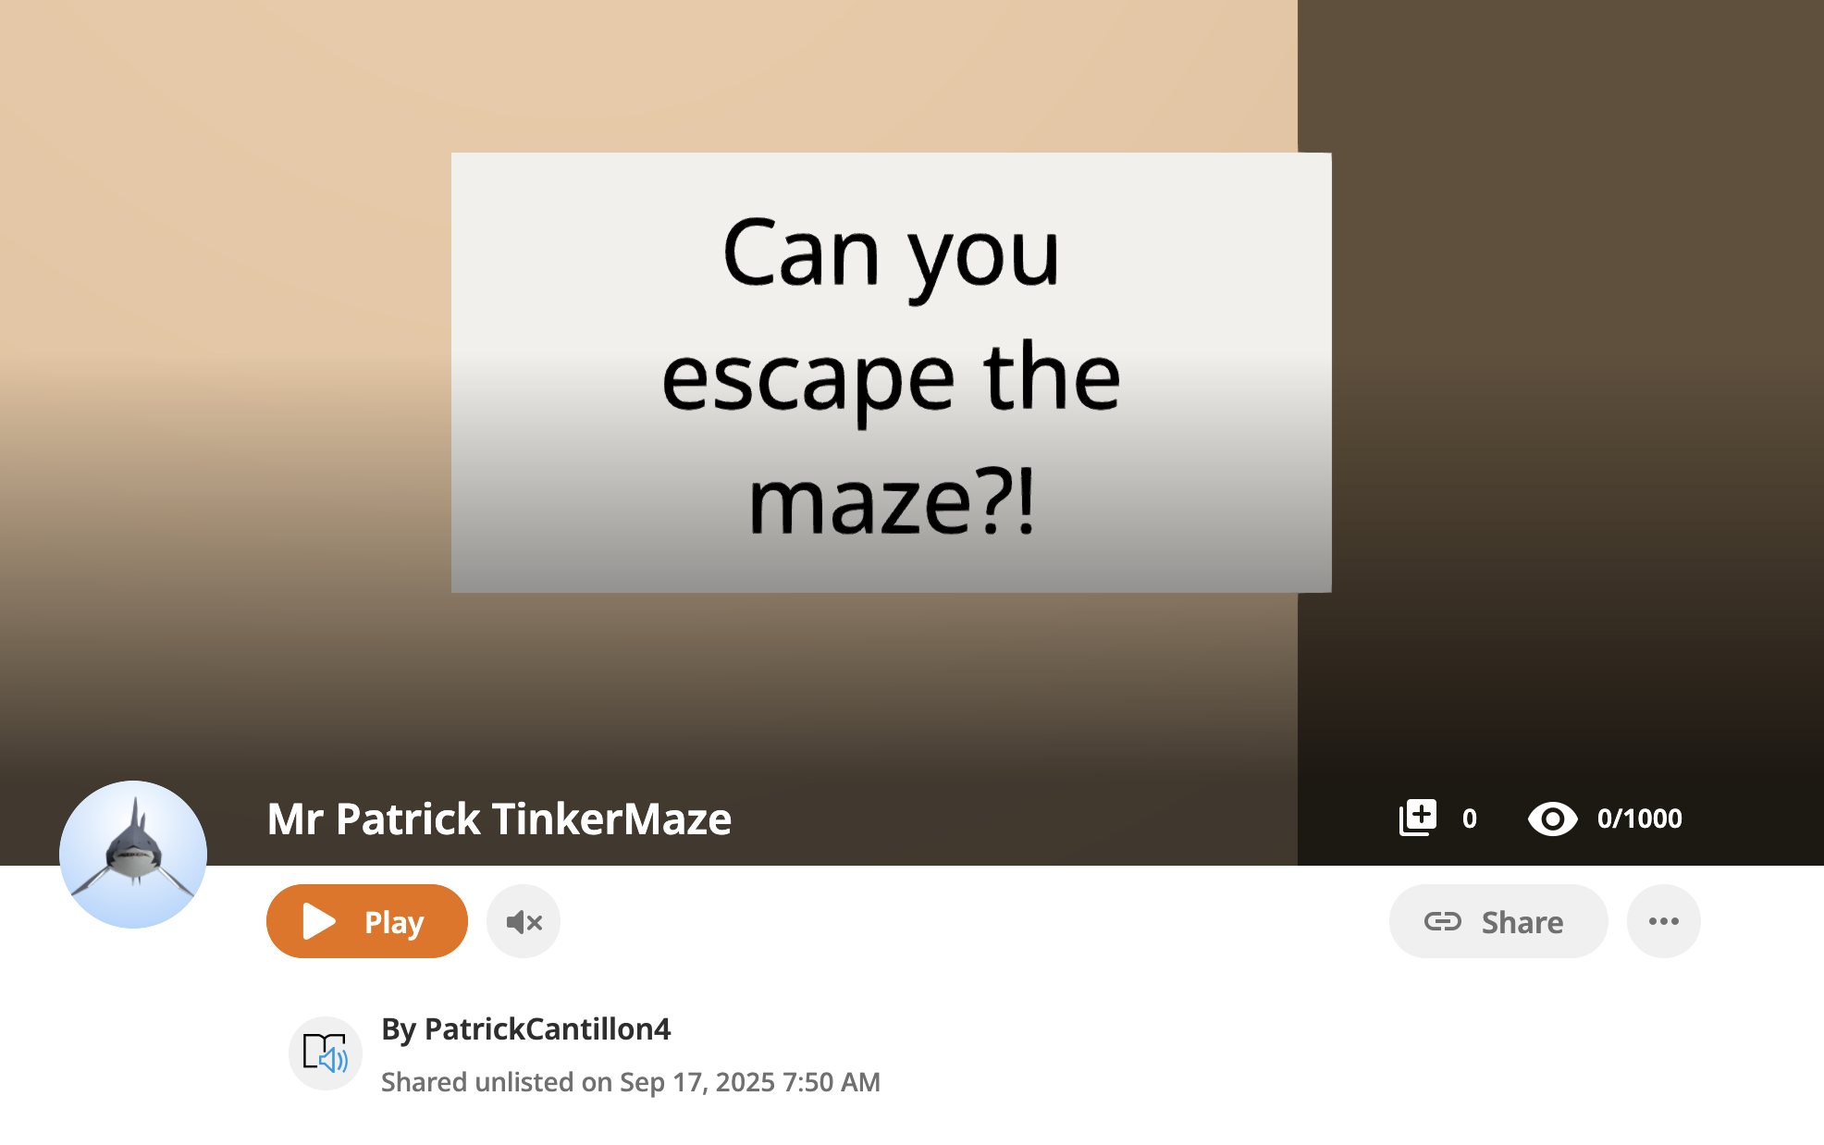
Escape your maze! DelightEx Edition
https://edu.delightex.com/PGH-KVD

Slide 17
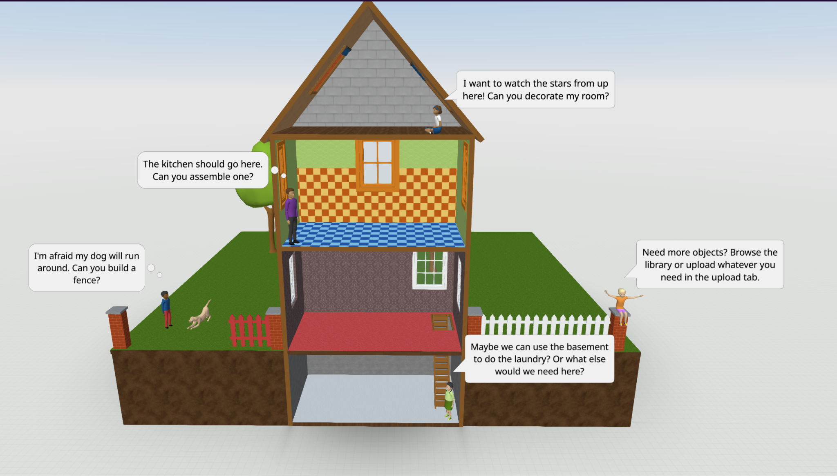
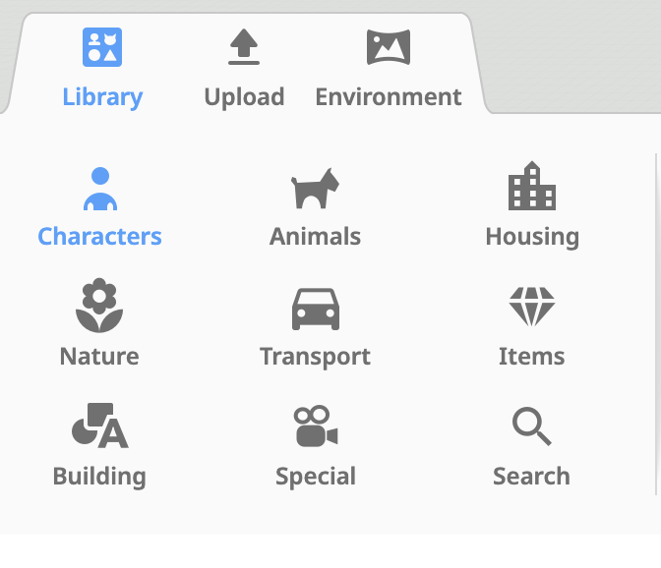
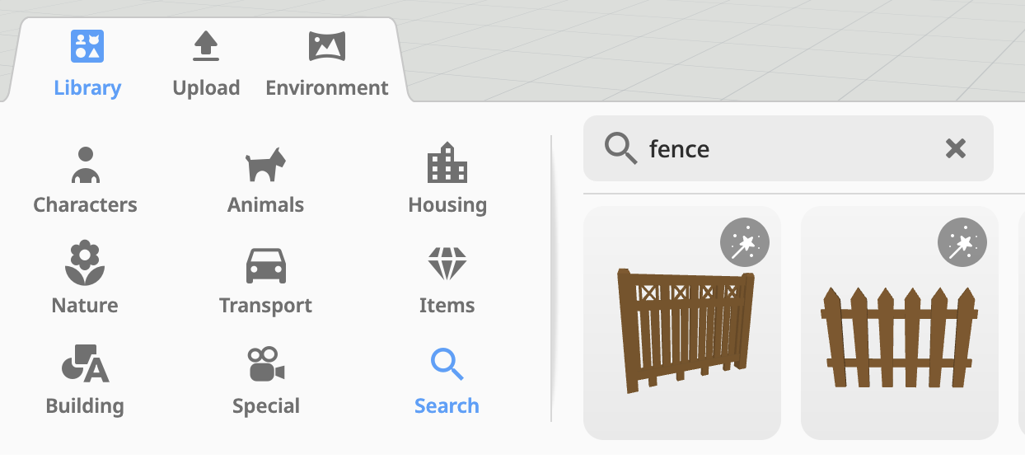
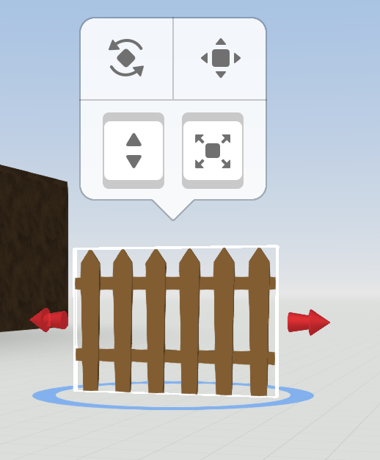
Using DelightEx - Basics
https://www.delightex.com/edu/local-editor
Tools:
Rotate
Translate
Lift
Scale

Slide 18
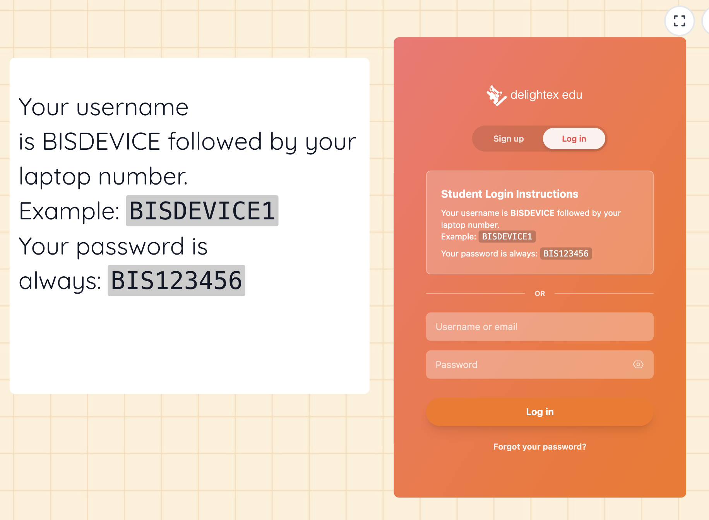

Slide 19
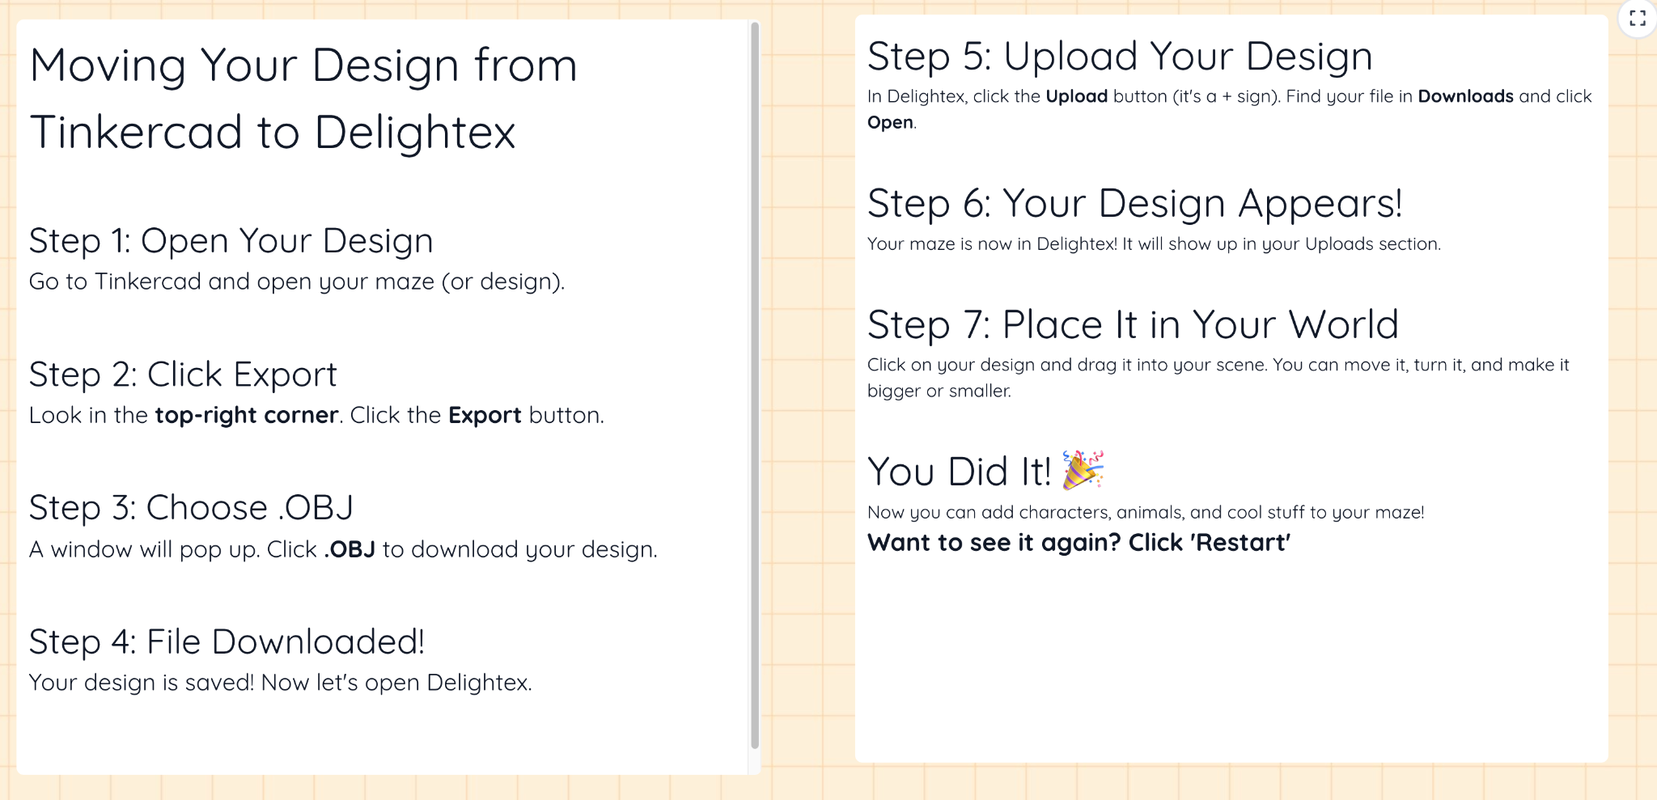
https://tinkercad-to-delightex-guide-801886913830.us-west1.run.app
Notes:
https://tinkercad-to-delightex-guide-801886913830.us-west1.run.app

Slide 20
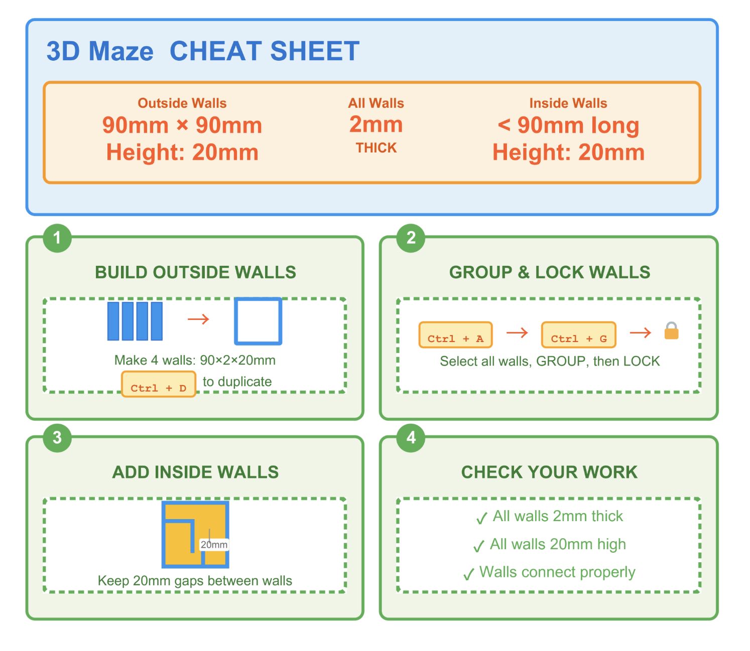
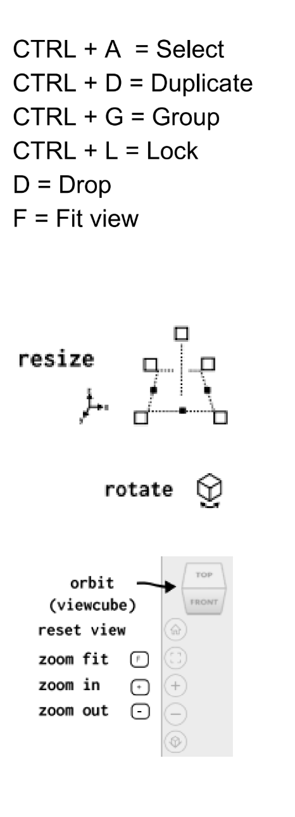
Keep space min 10mm

Slide 21
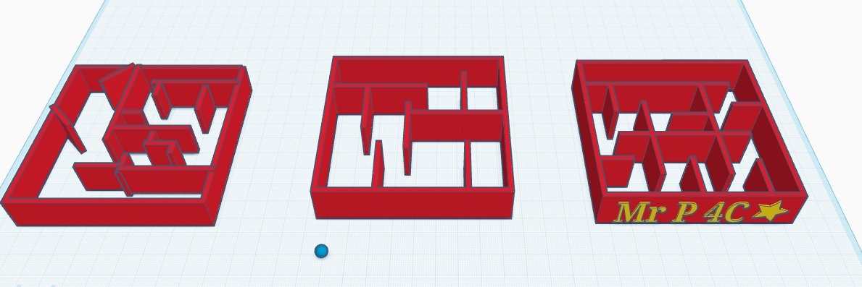
Which is the best?
Remember
Ball size 5mm x 5 mm x 5mm
Space between walls is 10mm
Hole in wall is : 15 mm
Notes:
https://www.tinkercad.com/things/jGUqvHWmsmY-which-is-best-maze/edit?returnTo=https%3A%2F%2Fwww.tinkercad.com%2Fdashboard&sharecode=B2AOEKgOaDud7Yq34C1GwdWLoIfngfUjDuRk2Pc64Xk

Slide 22
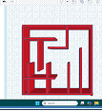
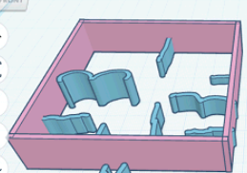
Watch out for these mistakes!
Walls not grouped
Walls poking out
Inside Walls all scribble
Walls too close

Slide 23
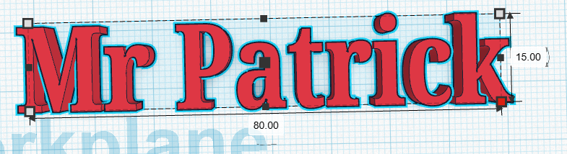
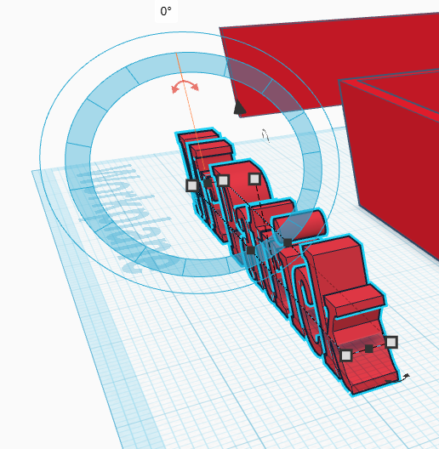

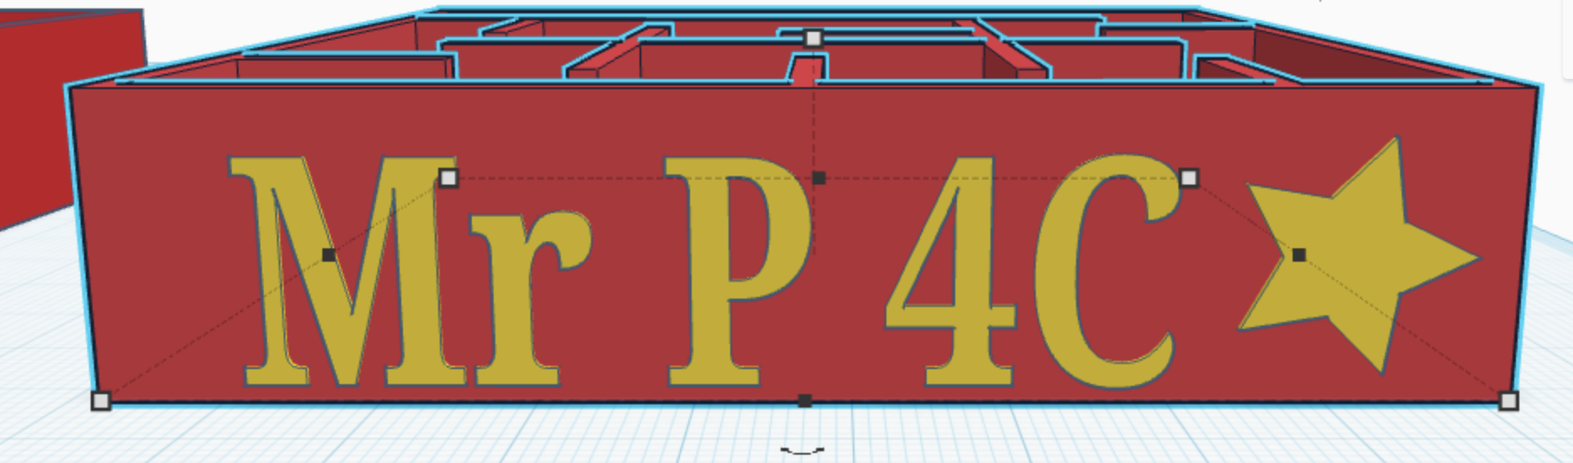
Adding a Name
Make sure your text dimensions are smaller than the wall
Set 90%

Slide 24
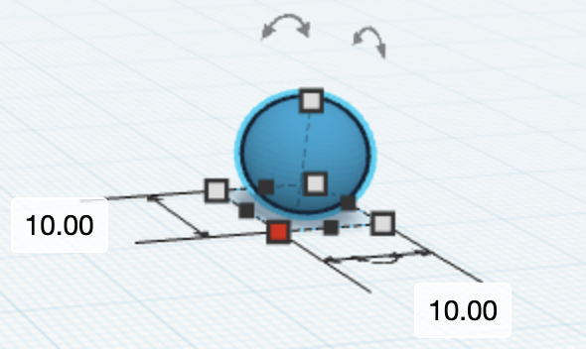
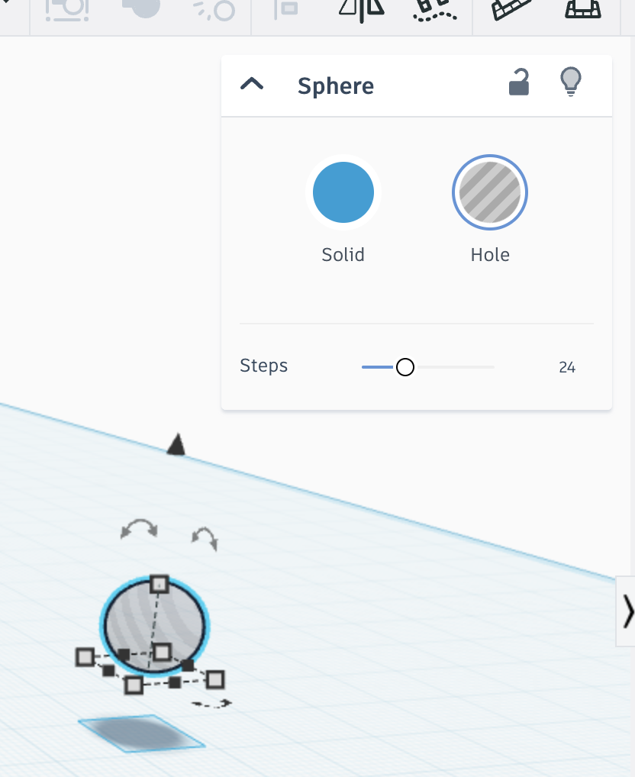
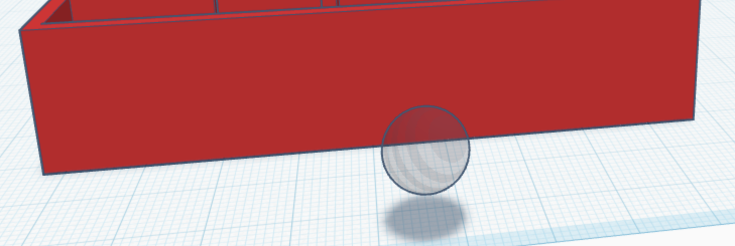
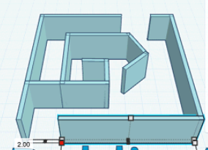
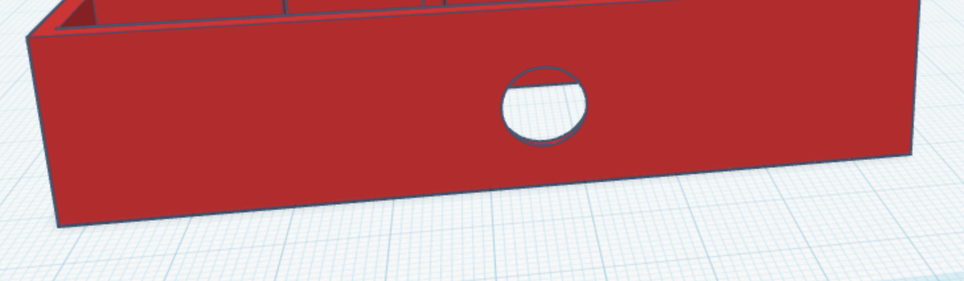
Adding a Hole
Don’t do this!

Slide 25
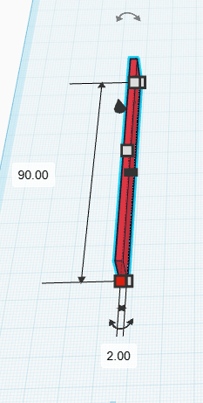
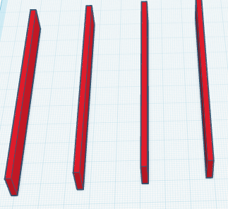
Stages of Design….
3
1
2
Notes:
Create first wall to Spec
Duplicate x 4 and rotate 90 degrees (will most likely have to model this)
Group walls (also can lock in place but will have to unlock to group inner walls later

Slide 26
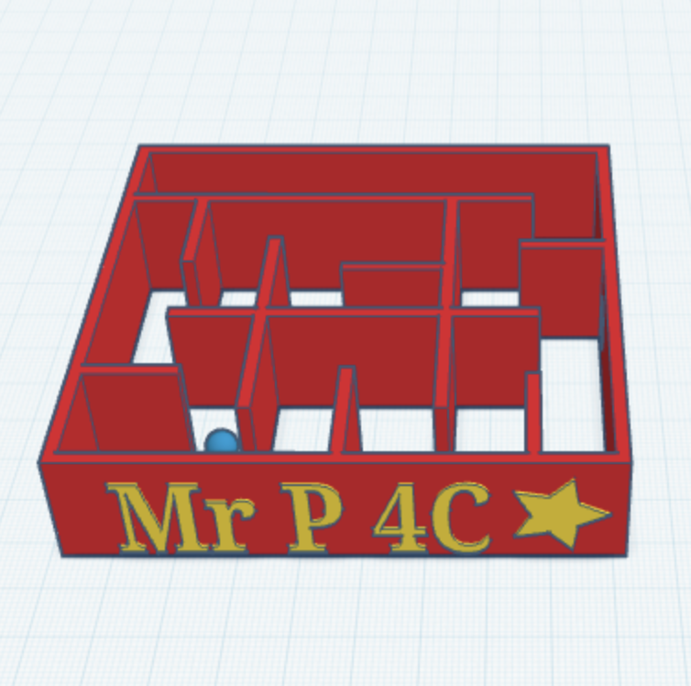
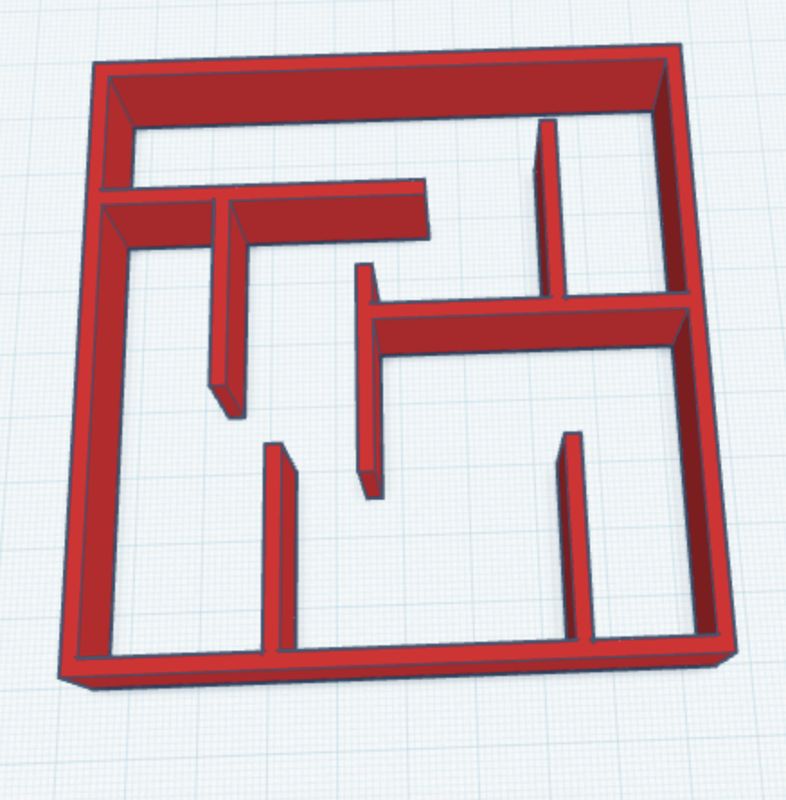
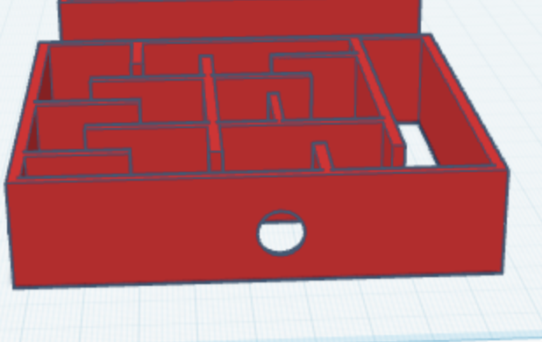
Stages of Design….
6
4
5
Notes:
4. Add in inner walls - make sure walls are attached not ‘touching’, pay attention to spec of walls/gaps between walls
5. Add text as name, will have to model how to rotate and indent, add in a ball to test spacing
6. Add in hole to wall - some students wanted to add in more than one hole of different sizes, make sure that hole/spher used is position equal amounts off the floor aother wise when comes to print ball wont fit

